Slide 1
Data Structures and Algorithms
Data Structures and Algorithms
Lecture 12 – Indexing & Searching
Miao Zhang

Slide 2
Search
Given: Distinct keys k₁, k₂, …, k_{n} and collection T of n records of the form
(k₁, I₁), (k₂, I₂), …, (k_{n}, I_{n})
where I_{j} is the information associated with key k_{j} for 1 <= j <= n.
Search Problem: For key value K, locate the record (k_{j}, I_{j}) in T such that k_{j} = K.
Searching is a systematic method for locating the record(s) with key value k_{j} = K.

Slide 3
Successful vs. Unsuccessful
A successful search is one in which a record with key k_{j} = K is found.
An unsuccessful search is one in which no record with k_{j} = K is found (and presumably no such record exists).

Slide 4

Average Search Length（ASL）
Comparison among keys： main operations in search
ASL(Average Search Length)
  Average comparison times
ASL is a function of n items
P_{i} is the probability of searching the i^{th} item
C_{i} is the comparison times for finding the i^{th} item

Slide 5
Search catagory
Static search
  Sequential Search
  Binary search
  Block search
Dynamic search
Hash search

Slide 6
Static search
Sequential search
Binary search
Block search

Slide 7
Sequential search
linear search or sequential search is a method for finding a target value within a list. It sequentially checks each element of the list for the target value until a match is found or until all the elements have been searched.
A successful search is one in which a record with key k_{j} = K is found.
  Otherwise failed.
Storage：array、linked list

Slide 8
Sequential search
1
Tom
Search Jack
Comparison: 2 times
2
Jack
Search John
Comparison: n - 1 times
. . .
Unsuccessful search
Comparison : n+1 times
n-2
Rose
n-1
John
n
Annie

Slide 9
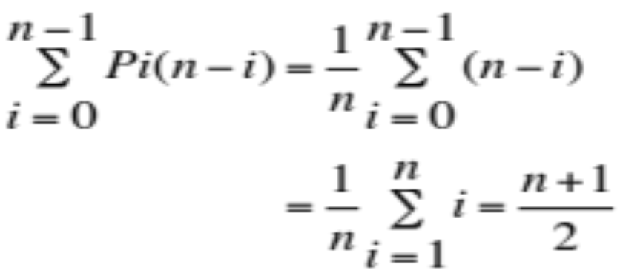
Sequential search
Successful search
Suppose that Pi = 1/n
Unsuccessful search
compared n+1 times（Set a sentinel）
Notes:
Suppose that the possibility of find each element is equal, which is 1/n.

Slide 10
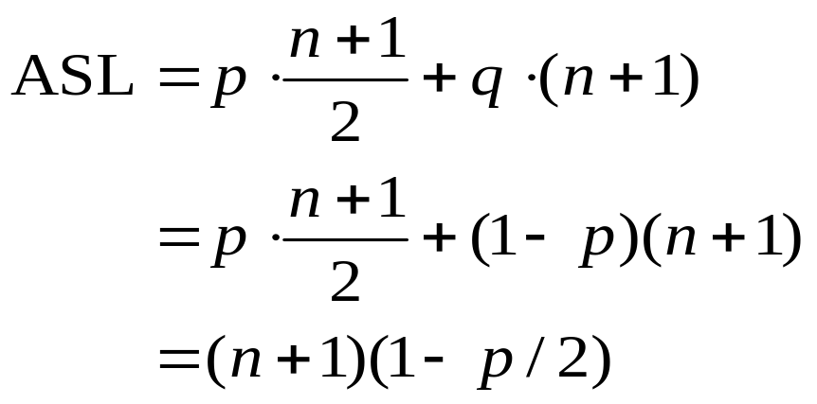
Sequential search(cont.)
ASL
Suppose probability of successful search is p，the one of unsuccessful search is q=(1-p)，
（n+1)/2 < ASL < (n+1)
Advantages：insert at the end of list.Θ(1)
Disadvantages：search Θ(n)

Slide 11
Static search
Sequential search
Binary search
Block search

Slide 12
Binary search
Binary search, also known as half-interval search or logarithmic search, is a search algorithm that finds the position of a target value within a sorted list.
Idea：
  Sort a list (in ascending order).
  Compare the K with middle item, if it is less than middle item，search in the previous half part; if not, search in the other half part.
  Repeat.

Slide 13
Binary search Ex.
Sorted list
5 ，13 ，19 ，21 ，37 ，56 ，64 ，75 ，80 ，88 ，92

Slide 14
mid = ( low + high ) / 2
1 2 3 4 5 6 7 8 9 10 11
5 ， 13 ， 19 ， 21 ， 37 ， 56 ， 64 ， 75 ， 80 ， 88 ， 92
low
mid
low
high
low
mid
low
low
mid
high
high
mid
high
mid
mid
Search 21
Search 85
mid = 6
high = mid – 1 = 5
mid = 6
low = mid + 1 = 7
mid = 3
low = mid + 1 = 4
mid = 9
low = mid + 1 = 10
mid = 4
Successful search.
mid = 10
high = mid – 1 = 9
high < low unsuccessful search

Slide 15
二分法检索算法
template<class T>
int BiSearch(T arr[], T key, int n) {
int left = 0; //定义查找范围的左端
int right = n-1; //定义查找范围的右端，n 表示数组的长度
int mid; //定义查找范围的中间点
while (left <= right) { //如果查找范围有效，则进行查找，否则结束查找
mid = (left + right) / 2;
if (key < arr[mid]) //将查找范围缩小到中间元素的左边
right = mid - 1;
else if (key > arr[mid]) //将查找范围缩小到中间元素的右边
left = mid + 1;
else //查找成功，返回该元素所在位置
return mid;
}
return -1; //查找不成功，返回-1
}

Slide 16
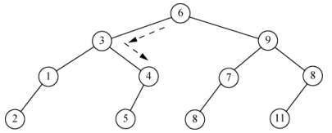
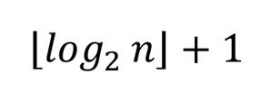
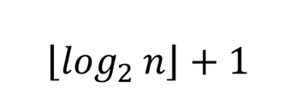
Analysis of Binary search
1 2 3 4 5 6 7 8 9 10 11
10，13，17，23，38，46，54，65，82，89，95
查找23
Longest SL
Unsuccessful SL

Slide 17

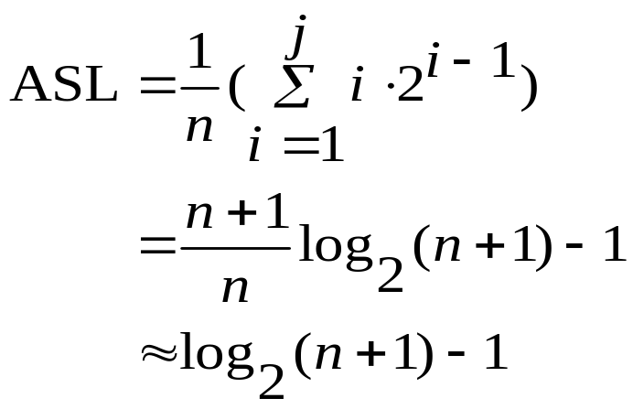

5 查找
二分法检索性能分析（续）
成功的平均检索长度为：
优缺点
优点：平均检索长度与最大检索长度相近，检索速度快
缺点：要排序、顺序存储，不易更新(插/删)

Slide 18
Succesful ASL
  Advantage：ASL is close to longest SL. Efficient for searching.
  Disadvantage： need to be sorted、not easy to update (insert/delete) for sequential storage .

Slide 19
Static search
Sequential search
Binary search
Block search

Slide 20
Block search
Combine sequential search and binary search
  Search fast
  Insert/delete easily

Slide 21
Block search
“Block is ordered”
  Suppose list has n items, divide them into b blocks.
    Size of blocks is not necessarily same.
    Each block is not necessarily full.
  Keys in the same block is not necessarily ordered.
  But the largest key of previous block must be less than the least key of preceding block.

Slide 22
Block search
 | key | link
0 | 14 | 0
1 | 34 | 5
Pos. | key | Other info.
0 | 8
1 | 14
2 | 6
3 | 9
4 | 10
5 | 22
6 | 34
7 | 18
8 | 19
9 | 31
Index
Key is the largest key in the block
The beginning position of the block
Number of items in the block.
Index is an ordered list
  Block is ordered.
Notes:
There are few things we need to pay attention to.
1, the key showed in the block list should be the largest key in the block
2, the beginning position of the block should be showed in the block list.
3, the number of the items in the block is not fixed as long as the the largest key of previous block must be less than the least key of preceding block.

Slide 23
Block search
（1）Determine the block
（2）Search items in the block

Slide 24
Block search——index sequential structure
0 1 2 3 4 5 6 7 8 9 10 11 12 13 14 15 16 17
 | 22 | 13 | 9 | 8 |  | 33 | 42 | 44 | 24 | 48 |  | 60 | 80 | 74 | 49 | 86 | 53
link:
 | 0 | 6 | 12
 | 22 | 48 | 86
Beginning position
Largest key
Key:

Slide 25
Block search
Two levels
  Find the block in the index；
    Time: ASL_{b}
  Search item in the block.
    Time: ASL_{w}
ASL(n) = ASL_{b} + ASL_{w}

Slide 26
Block search(cont.)
The first part utilizes the binary search，successful ASL:
  ASL= ASL_{b} + ASL_{w}
  ≈ log₂ (b+1)-1 + (s+1)/2
  ≈ log₂(1+n / s ) + s/2

Slide 27
Block search
Advantages：
  Insert\delete easily
Disadvantages：
  Not only one array
  Block is sorted
  When insert more items，searching gets slow. When the items are not well distributed，searching also gets slow.

Slide 28
Search catagory
Static search
  Sequential Search
  Binary search
  Block search
Dynamic search
Hash search

Slide 29
Indexing
Goals:
  Store large files
  Support multiple search keys
  Support efficient insert, delete, and range queries

Slide 30
Basic Concepts
Indexing is used to speed up access to desired data.
  E.g. author catalog in library
A search key is an attribute or set of attributes used to look up records in a file.
An index file consists of records called index entries.
An index entry for key k may consist of
  An actual data record (with search key value k)
  A pair (k, rid) where rid is a pointer to the actual data record
  A pair (k, bid) where bid is a pointer to a bucket of record pointers
Index files are typically much smaller than the original file if the actual data records are in a separate file.
If the index contains the data records, there is a single file with a special organization.

Slide 31





Linear Indexing
Linear index: Index file organized as a simple sequence of key/record pointer pairs with key values are in sorted order.
Linear indexing is good for searching variable-length records.
Linear indexing
92
73
37
55

Slide 32
B-Tree Definition
A B-tree is a specialized multiway tree designed
especially for use on disk.
A B Tree of order m is an m way tree such that:
  All leaf nodes are at the same level.
  All non leaf nodes (except the root) have at most m and at least m/2 children.
  The number of keys is one less than the number of children for nonleaf nodes and at most m and at least m/2 for leaf nodes.
  The root may have as few as 2 children unless the tree is the root alone.

Slide 33
B- tree
35
The number of its children node
Pointer
18
43 78
Same level
11
27
39
47 53 64
99
Terminal nodes
F
F
F
F
F
F
F
F
F
F
F
F
Leaves
External nodes
Unsuccessful search nodes

Slide 34
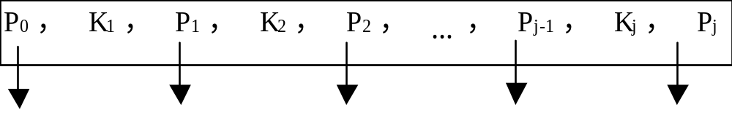
The node of B tree
A node of B- tree has j keys and j+1 branches.
K_{i} is the Keys，K₁<K₂<…<K_{j}，
P_{i} points to the subtree which includes the keys between K_{i} and K_{i+1}.

Slide 35
2-3 Tree
2-3 tree：
A node contains one or two keys.
Every internal node has either two children (if it contains one key) or three children (if it contains two keys). Hence the name.
All leaves are at the same level in the tree, so the tree is always height balanced.
The B-Tree is an extension of the 2-3 Tree.

Slide 36
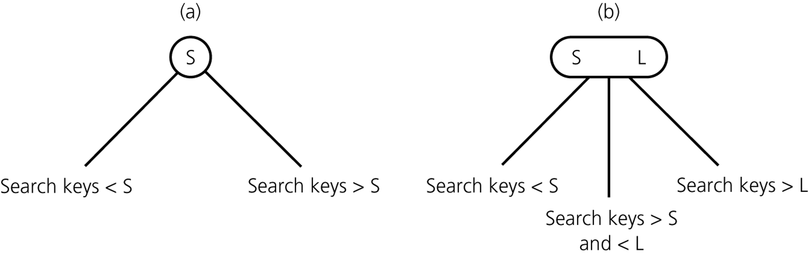
2-3 Trees with Ordered Nodes
2-node
3-node
leaf node can be either a 2-node or a 3-node

Slide 37

2-3 tree
18 33
12
23 30
48
10
15
20 21
24
31
45 47
50 52
The characteristic of tree shape?

Slide 38
2-3 tree
18 33
12
23 30
48
10
15
20 21
24
31
45 47
50 52
One or two keys for each node；
Two or three children for every internal node；
All leaves are on the same level。

Slide 39
2-3 tree
18 33
12
23 30
48
10
15
20 21
24
31
45 47
50 52
The characteristic of keys?

Slide 40
2-3 tree
18 33
12
23 30
48
10
15
20 21
24
31
45 47
50 52
The keys in the left subtree are all less than the leftmost key in its parent node；
The keys in middle subtree are all less than the rightmost key and greater than the leftmost key in its parent node.
The keys in right subtree are all greater than the rightmost key in its parent node.

Slide 41
2-3 tree search
18 33
18<21<33
12
23 30
21<23
48
10
15
20 21
24
31
45 47
50 52
21
Comparison times are not larger than the height of 2-3 tree.
Notes:
if we are trying to find the key 21,
first, we compare it with the root, and find which direction we are going.

Slide 42
2-3 tree insert
Insert new record in the leaf.
18 33
12
23 30
48
10
15
20 21
24
31
45 47
50 52
11
Leaf node has one record.
Insert new record

Slide 43
2-3 tree insert
Insert new record in the leaf.
18 33
12
23 30
48
10 11
15
20 21
24
31
45 47
50 52
Leaf node has one record.
Insert new record

Slide 44
2-3 tree insert
Insert new record in the leaf.
18 33
12
23 30
48
10
15
20 21
24
31
45 47
50 52
55
Leaf node has two records.
?

Slide 45
2-3 tree insert
Insert new record in the leaf.
18 33
12
23 30
48
10
15
20 21
24
31
45 47
50 52 55
insert
Leaf node has two records.
Insert the new record，divide leaf
and move middle value up to parent.

Slide 46
2-3 tree insert
Insert new record in the leaf.
18 33
12
23 30
48
10
15
20 21
24
31
45 47
50
52
55
Split
Leaf node has two records.
Insert the new record，divide leaf
and move middle value up to parent.

Slide 47
2-3 tree insert
Insert new record in the leaf.
18 33
12
23 30
48 52
10
15
20 21
24
31
45 47
50
55
Upgrade
Leaf node has two records.
Insert the new record，divide leaf
and move middle value up to parent.

Slide 48
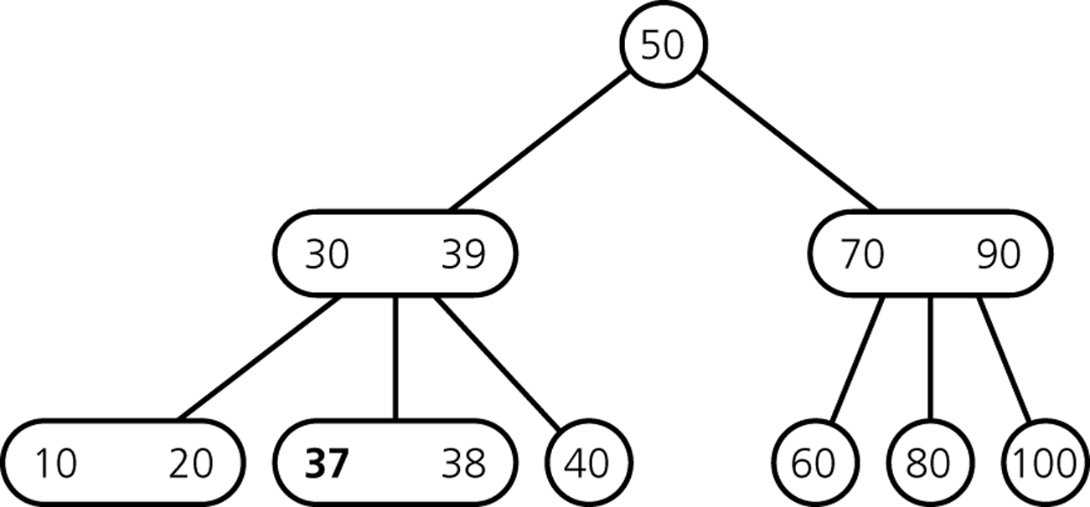
Exercise (1)
Insert 36

Slide 49
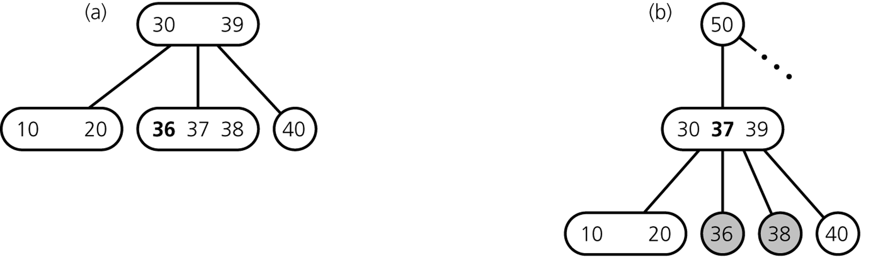
Exercise (1)
Insert 36
divide leaf
and move middle
value up to parent
insert in leaf
overcrowded
node

Slide 50
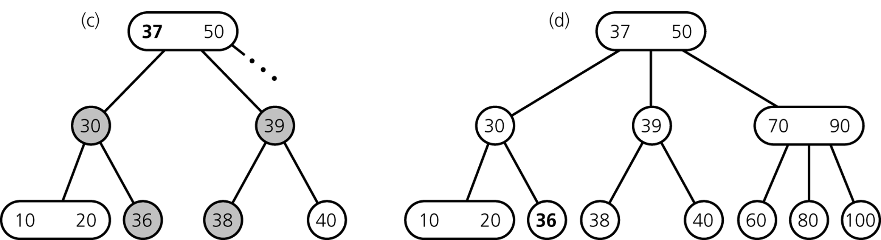
Exercise (1)
... still inserting 36
divide overcrowded node,
move middle value up to parent,
attach children to smallest and largest
result

Slide 51
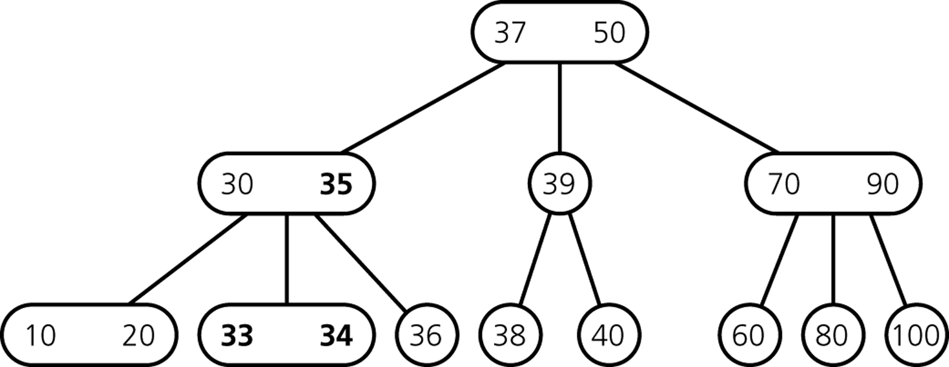
Exercise (2)
How do we insert 32?

Slide 52
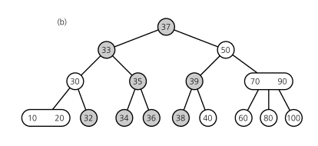
Exercise (2)
Final Result

Slide 53
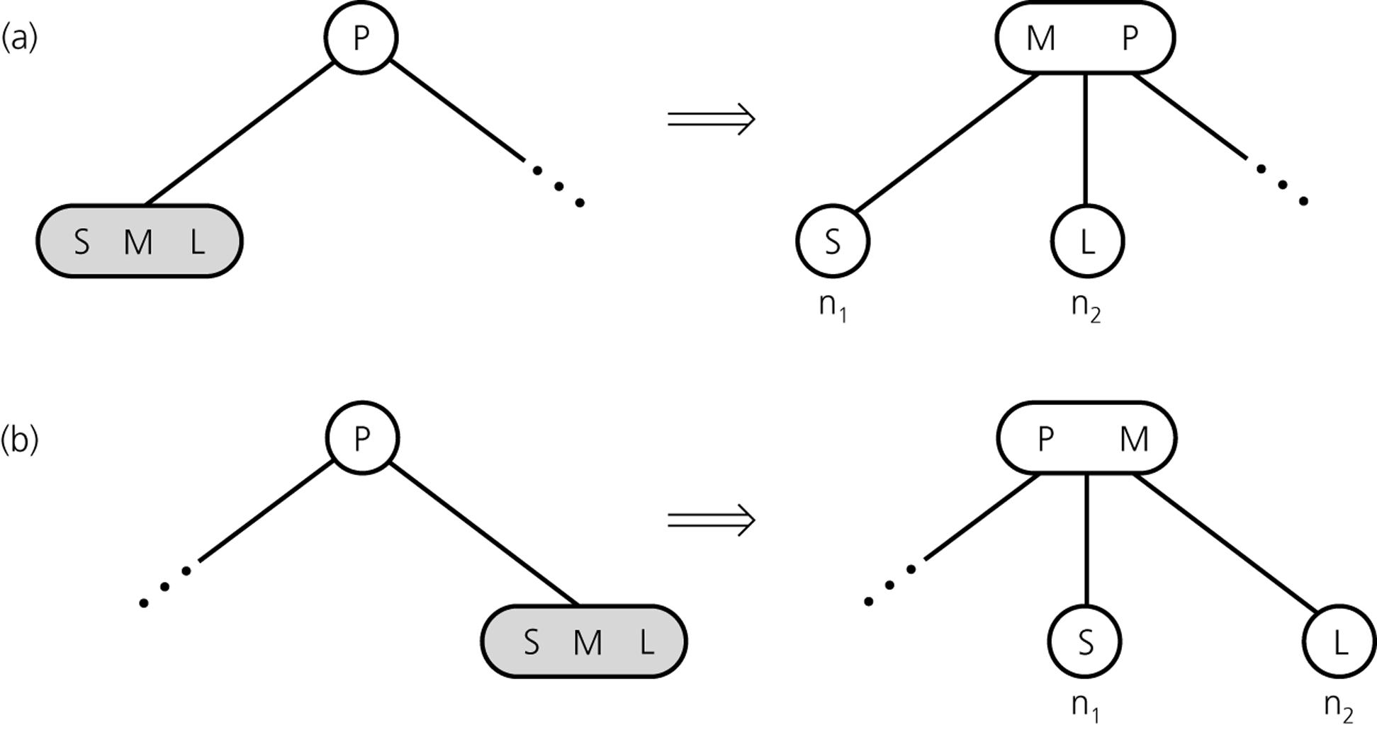
Inserting so far

Slide 54
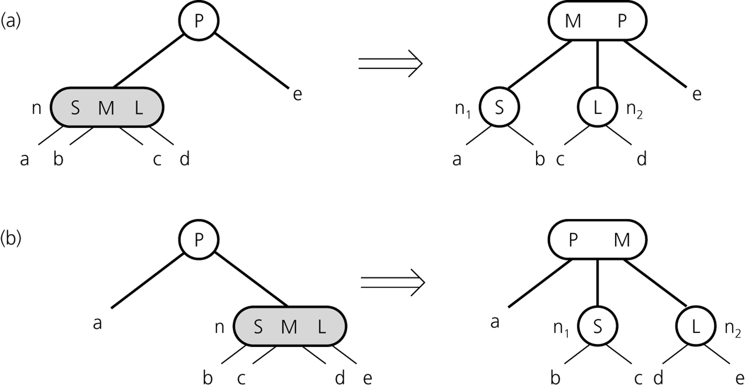
Inserting so far

Slide 55
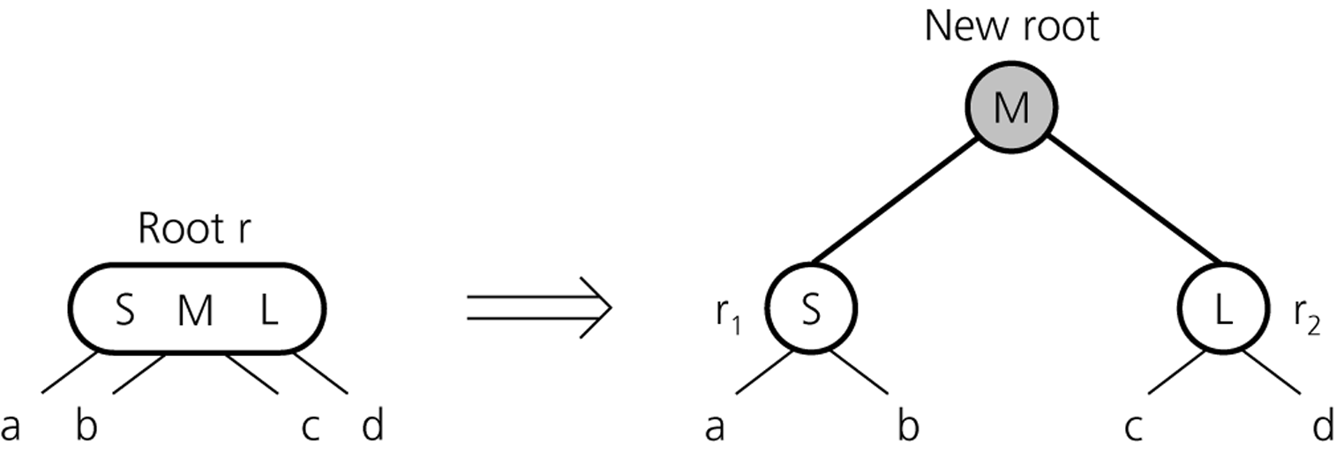
Inserting so far
creating a new root if necessary
tree grows at the root

Slide 56
2-3 Trees Insertion
To insert an item, say key, into a 2-3 tree
  Locate the leaf at which the search for key would terminate
  If leaf is null (only happens when root is null), add new root to tree with item
  If leaf has one item insert the new item key into the leaf
  If the leaf contains 2 items, split the leaf into 2 nodes n₁ and n₂

Slide 57
2-3 Trees Insertion
When an internal node would contain 3 items
  Split the node into two nodes
  Accommodate the node’s children
When the root contains three items
  Split the root into 2 nodes
  Create a new root node
  The tree grows in height

Slide 58
2-3 Tree Deletion
1：Delete one record from a leaf node with two records.
18 33
12
23 30
48
10
15
20 21
24
31
45 47
50 52
Delete this record directly.

Slide 59
2-3 tree delete
1：Delete one record from a leaf node with two records.
18 33
12
23 30
48
10
15
21
24
31
45 47
50 52
Delete this record directly.

Slide 60
2-3 tree delete
2(1)：Delete one record from a leaf node with one record.
18 33
12
23 30
48
10
15
20 21
24
31
45 47
50 52
Borrow a record from a brother，modify the record of parent node.

Slide 61
2-3 tree delete
2(1)：Delete one record from a leaf node with one record.
18 33
12
21 30
48
10
15
20
23
31
45 47
50 52
Borrow a record from a brother，modify the record of parent node.

Slide 62
2-3 tree delete
2(2)：Delete one record from a leaf node with one record.
18 33
12
21 30
48
10
15
20
23
31
45 47
50 52
Brother node does not have enough record，merge two nodes by deleting empty leaf and moving 21 down.

Slide 63
2-3 tree delete
2(2)：Delete one record from a leaf node with one record.
18 33
12
30
48
10
15
20 21
31
45 47
50 52
Brother node does not have enough record，merge two nodes by deleting empty leaf and moving 21 down.

Slide 64
2-3 tree delete
2(3)：Delete one record from a leaf node with one record.
18 33
12
30
48
10
15
20 21
31
45 47
50 52
Brother node does not have enough record，merge two nodes by deleting the empty leaf and moving 12 down. Modify the parent nodes based on the similar process.

Slide 65
2-3 tree delete
2(3)：Delete one record from a leaf node with one record.
33
18 30
48
10 12
20 21
31
45 47
50 52
Brother node does not have enough record，merge two nodes by deleting the empty leaf and moving 12 down. Modify the parent nodes based on the similar process.

Slide 66
2-3 tree delete
2(4)：Delete one record from a leaf node with one record.
33
25
48
20
30
45 47
50 52
Brother node does not have enough record，merge two nodes，modify parent node. This may reduce the height of the tree.

Slide 67
2-3 tree delete
2(4)：Delete one record from a leaf node with one record.
33 48
20 25
45 47
50 52
2-3 tree advantages：The advantage of the 2-3 Tree over the BST is that it can be updated at low cost.
Brother node does not have enough record，merge two nodes，modify parent node. This may reduce the height of the tree.

Slide 68
2-3 tree delete
3：Delete a record from internal node.
18 33
12
23 30
48
10
15
20 21
24
31
45 47
50 52
Replace the least key Y of the right subtree with the deleted key. Y must be in a leaf node. Then delete it.

Slide 69
2-3 tree delete
3：Delete a record from internal node.
20 33
12
23 30
48
10
15
21
24
31
45 47
50 52
The least key Y of right subtree replace the deleted key. Y must be in a leaf node. Then delete it.

Slide 70
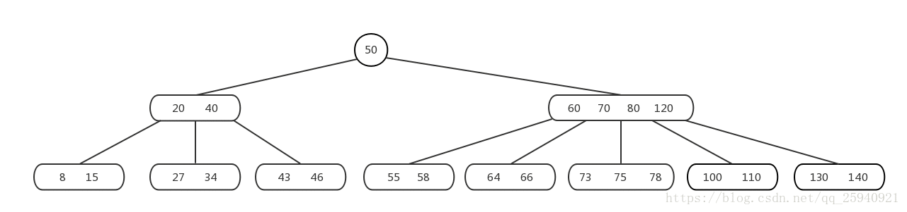
这是5阶B树，每个内部节点至少 5/2 = 2.5 ~= 3(取上界) 个子树，也就是至少 3-1 = 2 个关键码

Slide 71
B⁺-Tree
A B⁺-tree is a rooted tree satisfying the following properties:
All paths from root to leaf are of the same length
Each node that is not a root or a leaf has between ⎡n/2⎤ and n children.
Special cases:
  If the root is not a leaf, it has at least 2 children.
  If the root is a leaf (that is, there are no other nodes in the tree), it can have between 0 and (n–1) values.

Slide 72
B⁺-Tree Node Structure
Structure of an internal node (including the root node)
  K_{i} are the search-key values
  P_{i} are pointers to children (for non-leaf nodes) or pointers to records or buckets of records (for leaf nodes).
The search-keys in a node are ordered
K₁ < K₂ < K₃ < . . . < K_{n–1}
(Initially assume no duplicate keys, address duplicates later)

Slide 73
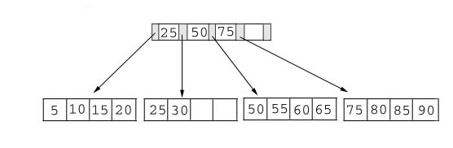
What is a B+ Tree
Example of a B+ tree with four keys (n = 4) looks like this:
Notes:
A B+ Tree combines features of ISAM (Indexed Sequential Access Method) and B Trees. It contains index pages and data pages. The data pages always appear as leaf nodes in the tree. The root node and intermediate nodes are always index pages

Slide 74
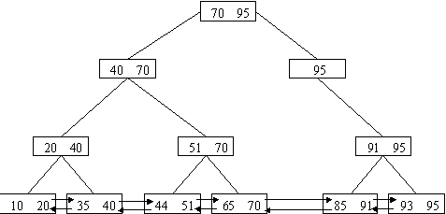
B⁺ tree

Slide 75
B⁺ tree Search
Search in the leaves level
  When find the keys in the internal node , do not stop.
  Keep searching following the pointer until reach the leaves.
B⁺ tree leaves are double-linked.
  Sequential search

Slide 76
B⁺ tree insertion
Since insert a value into a B+ tree may cause the tree unbalance, so rearrange the tree if needed.
Example #1: insert 28 into the below tree.
25 28 30
ok

Slide 77
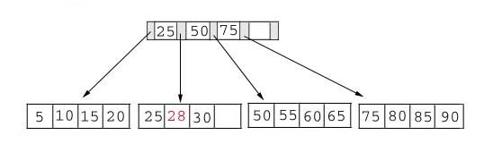
B⁺ tree insertion
Result:

Slide 78
B⁺ tree insertion
Example #2: insert 70 into below tree

Slide 79
Insertion
Process: split the tree
50 55 60 65 70
The node is overcrowded, which need to be splited
50 55
60 65 70

Slide 80
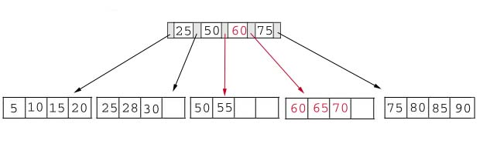
Insertion
Result: chose the middle key 60, and place it between 50 and 75.

Slide 81
Insertion
The insert algorithm for B+ Tree
Data Page Full | Index Page Full | Action
NO | NO | Place the record in sorted position in the appropriate leaf page
YES | NO | Split the leaf page Place Middle Key in the index page in sorted order. Left leaf page contains records with keys below the middle key. Right leaf page contains records with keys equal to or greater than the middle key.
YES | YES | Split the leaf page. Records with keys < middle key go to the left leaf page. Records with keys >= middle key go to the right leaf page. Split the index page. Keys < middle key go to the left index page. Keys > middle key go to the right index page. The middle key goes to the next (higher level) index. IF the next level index page is full, continue splitting the index pages.

Slide 82
Insertion
Exercise: add a key value 95 to the below tree.
25 50 60 75 85
75 80 85 90 95
Overcrowded node , split the leaf.
75 80
85 90 95

Slide 83
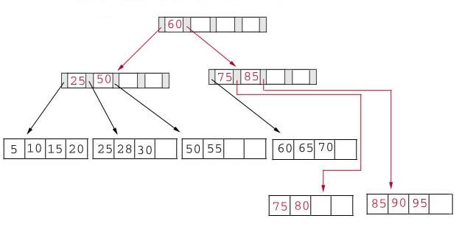
Insertion
Result: again put the middle key 60 to the index page and rearrange the tree.

Slide 84
B⁺ tree deletion
When the node is not full, take an adjustment with the brother node. It is similar to B- tree.
If the key is deleted in the leaf node, its duplicate could be reserved as a delimitation key.
The largest(least) key also can replace it.

Slide 85
Deletion
Same as insertion, the tree has to be rebuilt if the deletion result violate the rule of B+ tree.
Example #1: delete 70 from the tree
This is OK.
60 65

Slide 86
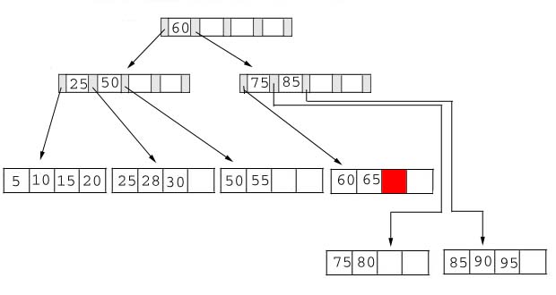
Deletion
  Result:

Slide 87
Deletion
Example #2: delete 25 from below tree, but 25 appears in the index page.
But…
28 30
This is OK.

Slide 88
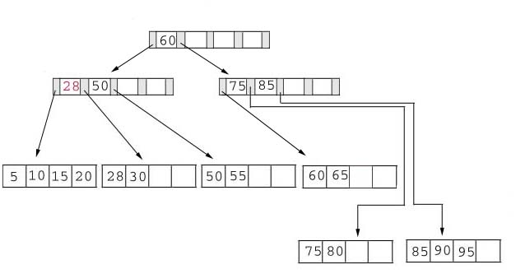
Deletion
Result: replace 28 in the index page.
Add 28

Slide 89
Deletion
Example #3: delete 60 from the below tree
65
Violet the 50% rule
50 55 65

Slide 90
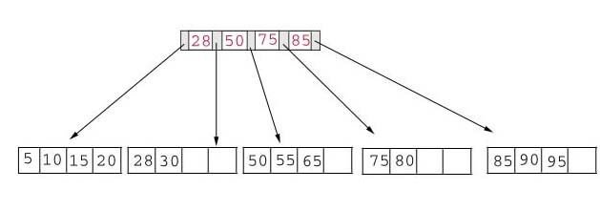
Deletion
Result: delete 60 from the index page and combine the rest of index pages.

Slide 91
Deletion
Delete algorithm for B+ trees
Data Page Below Fill Factor | Index Page Below Fill Factor | Action
NO | NO | Delete the record from the leaf page. Arrange keys in ascending order to fill void. If the key of the deleted record appears in the index page, use the next key to replace it.
YES | NO | Combine the leaf page and its sibling. Change the index page to reflect the change.
YES | YES | Combine the leaf page and its sibling. Adjust the index page to reflect the change. Combine the index page with its sibling. Continue combining index pages until you reach a page with the correct fill factor or you reach the root page.

Slide 92
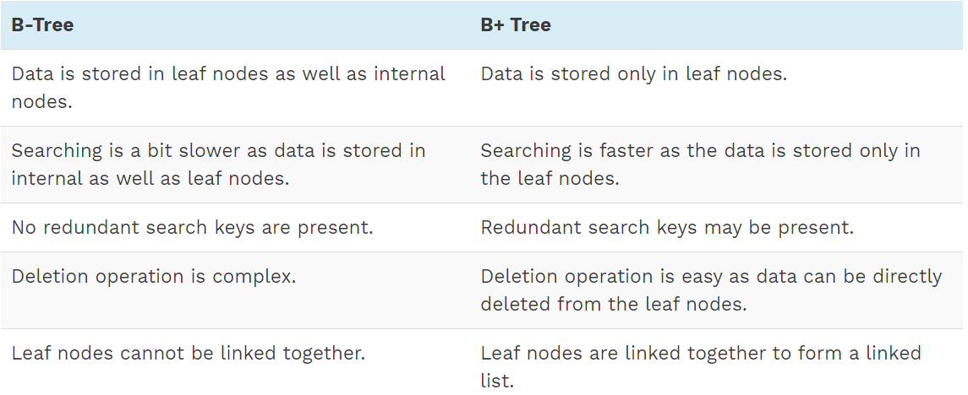
Difference Between B-Tree And B+ Tree

Slide 93
Exercises
Build a 2-3 tree using the keys:(68,54,82,35,75,90,103,22).
(1)Please draw the 2-3 tree.
(2)Then delete 22, 75. Draw the process.

